Slide 1
Microsoft CISO Workshop 5 - Information Protection Strategy
Microsoft Cybersecurity Solutions Group
Notes:
© Copyright Microsoft Corporation. All rights reserved. Microsoft, Windows, and other product names are or may be registered trademarks and/or trademarks in the U.S. and/or other countries. The information herein is for informational purposes only and represents the current view of Microsoft Corporation as of the date of this presentation. MICROSOFT MAKES NO WARRANTIES, EXPRESS, IMPLIED OR STATUTORY, AS TO THE INFORMATION IN THIS PRESENTATION.

Slide 2

“If you protect your paper clips and diamonds with equal vigor…
…you’ll soon have more paper clips and fewer diamonds.”
Attributed to Dean Rusk, US Secretary of State 1961-1969
Notes:
Key Takeaway: It’s critical to ensure that your information protection investments reflect the value of the information you are protecting.
The value of a document can vary significantly from assets that have a billion-dollar impact to others with near zero direct value (e.g. the cafeteria menu)

Slide 3
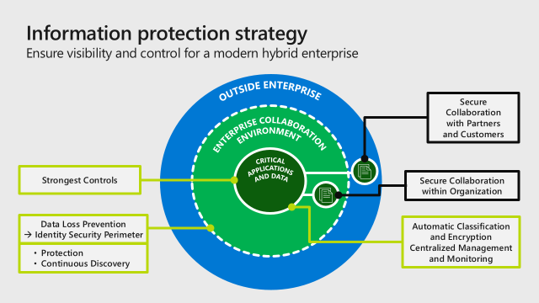
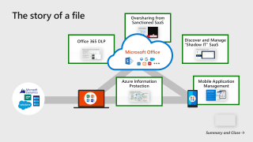

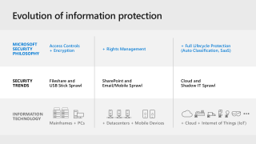


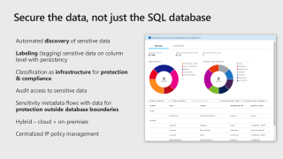


Information Protection
Maybe 2 part?
Re=use lifecycle of a file for “File protection”
SQL and Structured Data
Or maybe a “broad coverage across assets” imagery for menu shape?
TRENDS AND STRATEGIES
StrategY and Capabilities
Sensitive Documents
Information Protection Strategy
SQL and Structured Data
3rd party
TBD
Devices
Apps
Notes:
Key Takeaway: This is the module layout.
This slide uses the PowerPoint zoom feature, you can present it and click on each section to skip to it

Slide 4
Evolution of information protection
MICROSOFT SECURITY PHILOSOPHY
Access Controls + Encryption
+ Full Lifecycle Protection (Auto Classification, SaaS)
+ Rights Management
SECURITY TRENDS
Fileshare and USB Stick Sprawl
SharePoint and Email/Mobile Sprawl
Cloud and Shadow IT Sprawl
INFORMATION TECHNOLOGY
Mainframes + PCs
+ Datacenters + Mobile Devices
+ Cloud + Internet of Things (IoT)
Notes:
Key Takeaway: Microsoft invests in protections on data itself because sensitive data is often copied to untrusted devices/apps/services
As the IT world evolved, we saw the world of information protection evolve from Fileshare and USB stick data sprawl into SharePoint and Email/Mobile data sprawl and further into Cloud and Shadow IT data sprawl of today.
CLICK 1
Microsoft’s security philosophy has remained constant on protecting the data itself, but has evolved with the needs of our customers.
We started out with a basic access controls and encryption approach, but rapidly evolved into a rights management because of the need for centralized policy control and persistent protections on data that moves around a lot.
The difficulty of manual classification and the rise of Shadow IT SaaS has driven a need for Microsoft to build a full lifecycle protection solution for our customers. This includes automatic classification of data and Cloud App Security Broker (CASB) capability to discover and manage SaaS application risk.

Slide 5
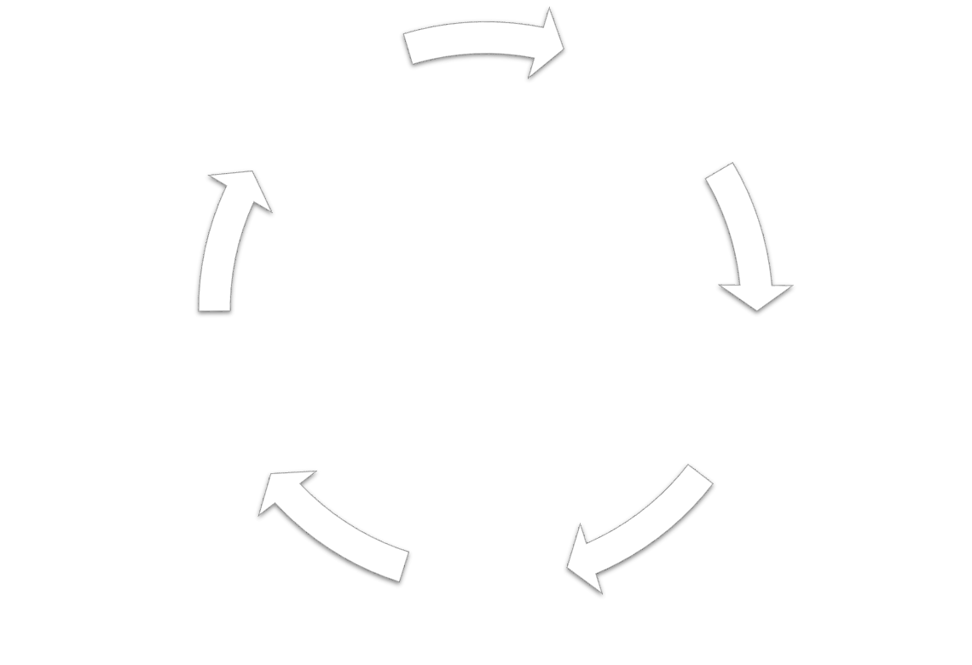

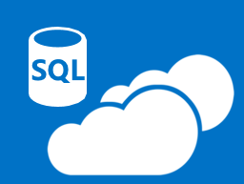
Data security challenges
?
?
Reduce and Manage Risk of User Errors
Collaboration to create new business value requires data sharing and data mobility
Critically important to prevent unauthorized disclosure, modification, or destruction
Classification is Challenging
Manual user classification is impractical at scale
Large set of existing documents and more being created all the time
Data Must Be Protected Outside of the Network
Data must be protected as it traverses mobile devices and cloud services
Data created outside the network must be classified and protected
Compliance and Security Require a Complete Strategy
Compliance penalties are increasing and measuring outcomes vs. methods
Need full lifecycle protection for information assets (appropriate to valuation)
Notes:
Key Takeaway: Key data security challenges include reducing and managing user errors, data classification, data protection outside network, and data compliance.
Reduce and manage risk of user errors
As many of us have experienced with urgent requests by executive leadership, creating and updating sensitive documents frequently involves
multiple stakeholders within the organization
working quickly to meet an important deadline
Working on different devices in different locations
Uncertainty about whether the leadership will agree with or modify the outcome
In this type of situation, adding a manual process to analyze the full document content and precisely classify it can be difficult and distracting from the immediate business goals.
We need to help users easily make these decisions to protect their business without slowing it down.
CLICK 1
We also need to protect both
A significant backlog of content that has built up over time
The constant stream of new documents being create created.
CLICK 2
The data that we must to protect is frequently created or transferred outside the networks we manage (and often gets used on unmanaged devices and cloud services)
CLICK 3
We are also seeing an increase in compliance requirements that measure outcomes (compromised data) rather than the methods (encrypted data). We are also seeing an increase in the fines from regulations like the General Data Protection Regulation (GDPR) in the European Union.
This and the elevated threat environment are driving a need for full lifecycle protection that
Protects all the sensitive data
Protects data throughout its life cycle

Slide 6
Top Information Protection Use Cases DISCOVER – CLASSIFY – PROTECT – MONITOR
Information Protection and Data Governance Strategy
Label, track, and show data loss or manipulation of a file.
Implement corporate policies to protect different levels of sensitive data
Protecting sensitive information
Challenging to discover and classify data across mobile devices, SaaS, cloud infrastructure, and on-premises
Need full lifecycle data protection for identified data including encryption, permissions, visual markings, access revocation, retention and deletion
Notes:
Key Takeaway: These are the key information protection use cases we see organizations focusing on

Slide 7
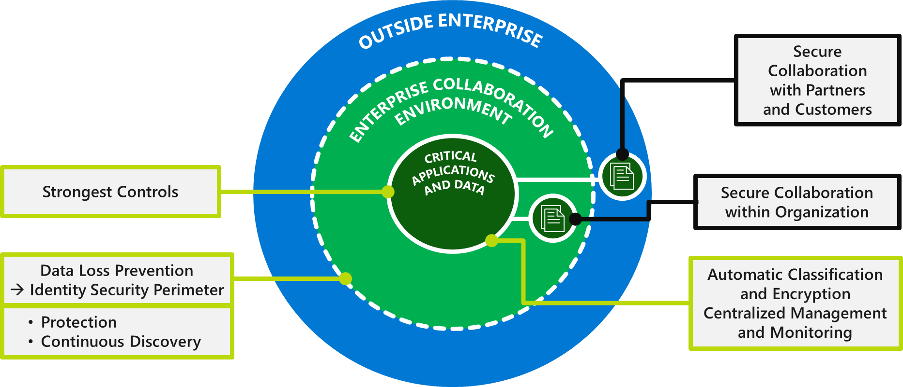
Information protection strategy Ensure visibility and control for a modern hybrid enterprise
OUTSIDE ENTERPRISE
Secure Collaboration with Partners and Customers
ENTERPRISE COLLABORATION ENVIRONMENT
Strongest Controls
Secure Collaboration within Organization
CRITICAL APPLICATIONS AND DATA
Data Loss Prevention
→ Identity Security Perimeter
Automatic Classification and Encryption
Centralized Management and Monitoring
Protection
Continuous Discovery
Notes:
Key Takeaway: This is a reference information protection strategy designed to balance security and productivity
Business critical data should have the strongest controls spanning people process and technology, including clear policy and user training, business processes, and the full spectrum of technical/security capabilities (identify, protect, detect, respond, recover)
CLICK 1
To enable daily productivity, your collaboration environment should be focused on providing both user productivity and security. The edge of this enterprise environment has traditionally been defined by a network perimeter (managed hosts on a corporate network with DLP on the network edge and hosts), but is now shifting to an identity security perimeter defined by authentication and access controls on accounts, devices, and cloud services.
CLICK 2
To enable collaboration of the most sensitive information, we should now extend those strong assurances with the data while enabling collaboration within the production and environment and with key partners (e.g. M&A documents with legal counsel and other stakeholders, sensitive product specifications with suppliers, pre-announcement information with key stakeholders, protection of regulated information, etc.)
The keys to enabling this securely are
Automatic classification, persistent encryption, and centralized monitoring and revocation
Continuous discovery to capture accidental leaks (e.g. through monitoring SaaS applications with cloud application security broker (CASB) in the identity security perimeter)

Slide 8
Strategy core goal Protect at the appropriate level
3
HIGHEST VALUE ASSETS
Level 2 + Specialized Protection and processes
2
SENSITIVE INFORMATION
Reduce risk of theft, modification, and destruction
1
BASELINE PROTECTION
Building an Identity Security Perimeter
Notes:
Key Takeaway: There are three information protection strategic objectives based on the relative value/risk to the business
To maximize the return on your investment of resources, we recommend you establish a baseline protection to cover all of data that isn’t explicitly public. These protections serve as the minimum protection for data (and the only protection for lower sensitivity data) and is the de facto strategy we see most organizations using. While many organizations are still attempting to provide baseline protection by restricting data to managed corporate PC behind corporate firewalls/VPNs, we recommend upgrading to an identity security perimeter approach to keep up with current attacks and user productivity needs. Microsoft’s identity security perimeter approach is described in detail in the identity and access management module of this workshop
CLICK 1
For sensitive information that may have a significant or material impact on the organization’s business (such as regulated data, trade secrets, and other confidential information), we recommend an additional level protection to reduce the risk of theft modification or destruction of that information.
This presentation will focus on the recommended strategy to protect this sensitive information.
CLICK 2
The highest value assets will have a significant (and likely material) impact on the organization’s business or mission. The protection of high value information assets should build on the sensitive information protections (Level 2 in this diagram) and add specialized protections and processes that match the value and use cases of those assets.
We will be focusing primarily on protecting sensitive information (Level 2) in this presentation
Additional Information
Which information assets fit into each level will vary depending on your organization’s business strategy and how it maintains a competitive advantage
The asset classification exercise for this can also benefit your business in several other ways such as
Protecting and recovering from destructive/ransomware attacks
Improving resiliency of critical systems during business continuity risks

Slide 9


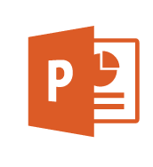





Success criteria—information protection
Information Protection and Data Governance Strategy
COVERAGE – Structured and unstructured, backups, SaaS, etc.
INTEGRATION – New capabilities with existing DLP processes (and tools)
Sensitive Information Success Criteria
Centralized control – Monitor and revoke access to documents
Automatic classification – Of new, existing, and exported documents
Embedded protection – Protect the data, not just storage/networks
Persistent protection – For your sensitive data anywhere it goes
FULL STACK FOR HIGHEST VALUE ASSETS – Host/device/identity/etc. security + user education
Notes:
Key Takeaway: These are the recommended focus areas for defining success of an information protection program:
Coverage - The program needs to address the full set of sensitive assets and the different data formats (structured, unstructured) and locations (SaaS applications, on-premises datacenters, backup copies, etc.)
Integrate - Any new capabilities should leverage existing processes that users have been trained on (and any tools that aren’t being replaced by the new capability)
Full Stack – Higher value assets may provide enough reward for adversaries to develop and execute advanced attack techniques to access the data (zero day device/host vulnerabilities, reading encryption keys from memory, etc.)
CLICK 1
You should focus on reducing the risk to sensitive documents as these files are frequently shared in unencrypted form on mobile devices and cloud file sharing applications
Centralized control – Organizations should have centralized ability to monitor the usage patterns of sensitive documents and revoke access rights to documents in case they are compromised
Automatic Classification – End users need help with classifying and labelling both existing documents and new ones as they are created
CLICK 2
Embedded protection – We have learned that effective protection of sensitive data should require the documents to be protected individually, not just as part of broad device or storage volume protections.
CLICK 3
Persistence –The protections must persist with the data as it inevitably traverses between devices and services and over networks

Slide 10
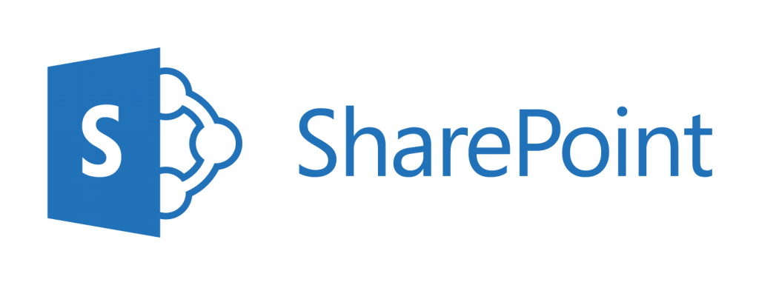








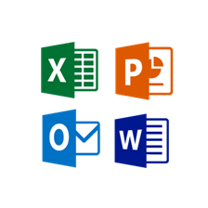
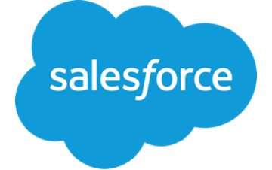
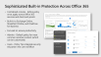
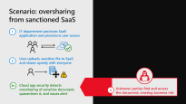
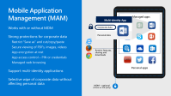
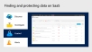
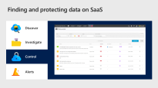


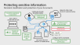



The story of a file
Oversharing from Sanctioned SaaS
Office 365 DLP
Discover and Manage “Shadow IT” SaaS
Microsoft Office
Azure Information Protection
Mobile Application Management
Summary and Close →
Notes:
Key Takeaway: This map shows how Microsoft have invested in finding and protecting sensitive files throughout their lifecycle
Click on any of the “zooms” to see more information on the capabilities

Slide 11
Success criteria—information protection
Information Protection and Data Governance Strategy
COVERAGE – Structured and unstructured, backups, SaaS, etc.
INTEGRATION – New capabilities with existing DLP processes (and tools)
Sensitive Information Success Criteria
Centralized control – Monitor and revoke access to documents
Automatic classification – Of new, existing, and exported documents
Embedded protection – Protect the data, not just storage/networks
Persistent protection – For your sensitive data anywhere it goes
FULL STACK FOR HIGHEST VALUE ASSETS – Host/device/identity/etc. security + user education
Notes:
Key Takeaway: This is a review of the recommended focus areas for defining success of an information protection program:

Slide 12
Questions?

Slide 13
References

Slide 14
Additional Resources – Information Protection
Microsoft Cloud App Security integration with 3rd party DLP engines
https://cloudblogs.microsoft.com/enterprisemobility/2018/01/30/microsoft-cloud-app-security-integrates-with-third-party-data-loss-prevention-solutions/

Slide 15
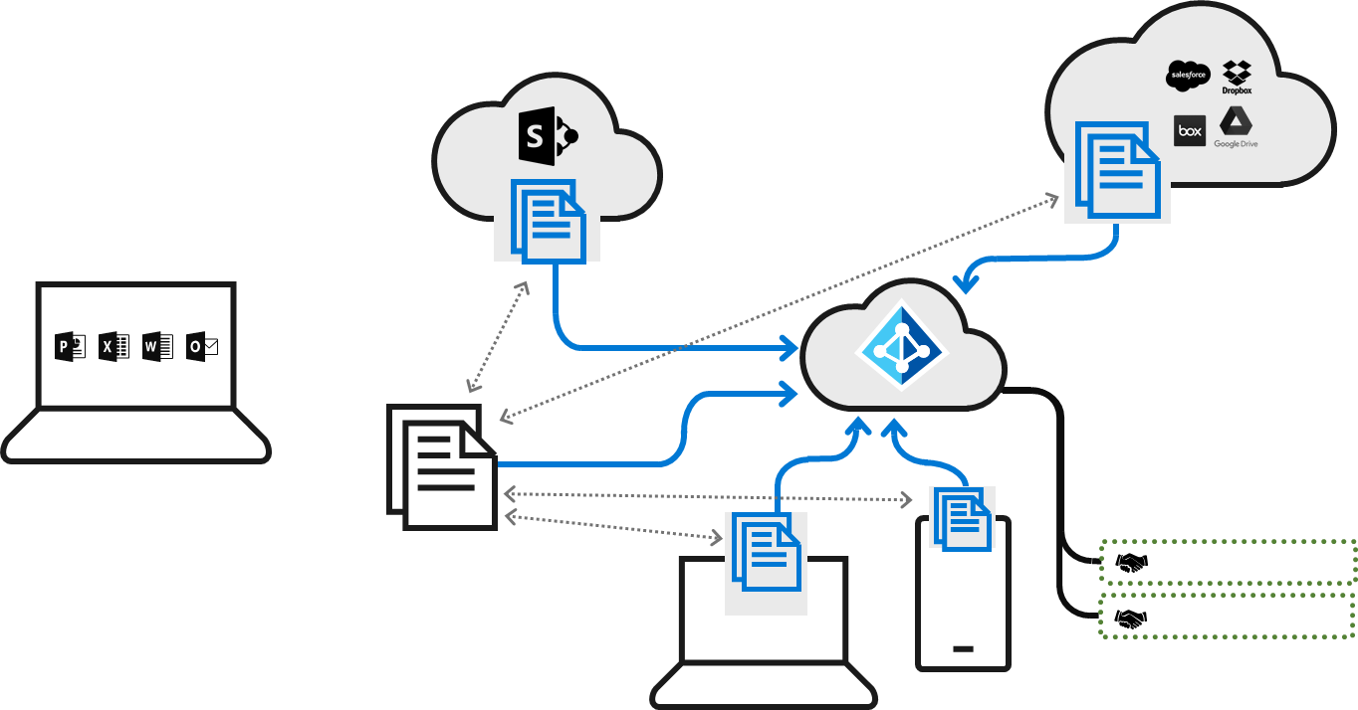






Protecting sensitive information Persistent classification and protection of your documents
Upload to other cloud service for external sharing
Collaborate through SharePoint Online
Set policies appropriate to organization
Collaborate with existing tools
User creates a sensitive file at work
Centralized control of keys and data
Monitor and
Revoke Access
Revoke Access
Classify and Label Data Automatically
Edge DLP
Policy and encryption persists on data
Endpoint DLP
Configure DLP to read labels
User opens file from home PC or mobile device
Leverage Existing Tools and Processes
Notes:
Key Takeaway: Microsoft Azure Information Protection enables you to protect sensitive information throughout its lifecycle
The process starts with setting policies that meet both productivity and security needs for your organization
CLICK 1
Automatic (or manual) classification of the document would then trigger the protection of the document and the centralized control.
CLICK 2
Users can then collaborate easily using SharePoint Online and the protections and centralized reporting and control will continue
CLICK 3
Additionally, the document will retain the same strong protections and centralized monitoring even if it is used on other cloud services, mobile devices, or home PCs
CLICK 4
Because of the centralized control of the keys and policy, users can track the document activity and revoke access to it.
https://docs.microsoft.com/en-us/information-protection/rms-client/client-track-revoke
CLICK 5
Azure Information Protection labels can be easily integrated into an existing DLP solutions (clear text label stored in custom properties for documents, label in the headers for email).
Additional Information
The encryption on the document will persist and access to it will require the application opening it to “phone home” to the central service for (temporary) access to the keys that can decrypt it. You can control how long the keys are retained using policies configured on the service.
Any authorized user can read the document from many devices including iPads, iPhones, Android tablets and phones, Mac computers, and Windows computers
Cloud App Security (Microsoft’s CASB) has integrated support for the labels

Slide 16
Modern information protection Collaborate securely with partners
Documents restricted to only authorized users
Enable simple external collaboration
Document Owner authorizes access to an external Partner (supplier, customer, etc.)
Configure labels on DLP
Partner opens the file for reading or editing
Notes:
Key Takeaway: Microsoft also enables this document protection for collaboration with your partners
Many sensitive documents need to be shared with selected external people like external legal counsel, key suppliers, and other partners.
CLICK 1
Document owners can grant access to the document to the external party. When the person receives the file, they are given instructions how to read the document.
CLICK 2
When they open the document, it is tracked and subject to revocation just like any other authorized user

Slide 17
Key classification scenarios
Automatic
Set policies to automatically applying classification and protection to data
Recommended
Prompt with suggested classification based on the content you’re working on
Reclassification
Enable users to override a classification (and optionally require providing a justification)
User Set
Manually apply a sensitivity label to the email or file they are working on
Notes:
Key Takeaway: This is a summary of the different ways to enable document classification
Pragmatic automatic classification has to balance good user security experience, security policy, and preserving human judgement and accountability
Automatic and Recommended - Automation can automatically classify labels and documents (no human interaction required) or to recommend a classification to the user
CLICK 1
Reclassification and User Set – Because automation can’t always get it right, users can reclassify documents and manually set the classification on any document.
Azure Information Protection supports all four of these cases today and the activities are logged so IT can audit in case of violation (including requiring justification for lowering classification levels)

Slide 18

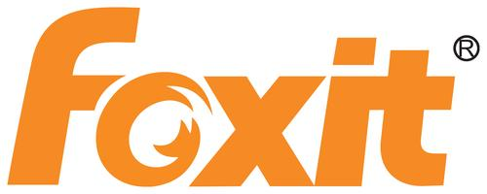


Support required formats for sensitive data Coverage for popular formats + extensibility
Microsoft Office Formats
PDF
AutoCAD
Others
Built into
Microsoft Office
Partner(s)
Partner(s)
SealPath
SAP Data Export
…and more
…and more
SDK
Software Development Kit
Notes:
Key Takeaway: Azure Information Protection Supports most popular document formats for sensitive information.
Microsoft Office includes built in support for those document formats and emails
CLICK 1
We have several partners that offer PDF format protection support
CLICK 2
We also have partners that allow you to protect AutoCAD documents.
CLICK 3
We have a number of other partners to protect other key information protection scenarios such as protecting data exported from SAP systems and more
We also offer an SDK to allow you (or your other suppliers) to protect any document format.
We have found this format support typically covers the requirements for sensitive documents at most organizations. If you require any other formats to have this protection, our product group is very interested in hearing your feedback on any required formats or scenarios to help you protect your sensitive data.

Slide 19
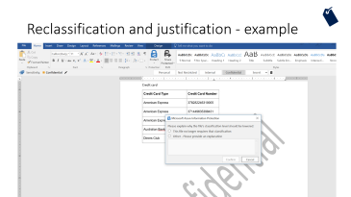
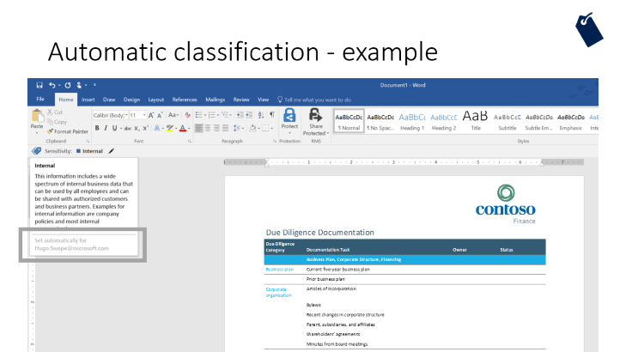
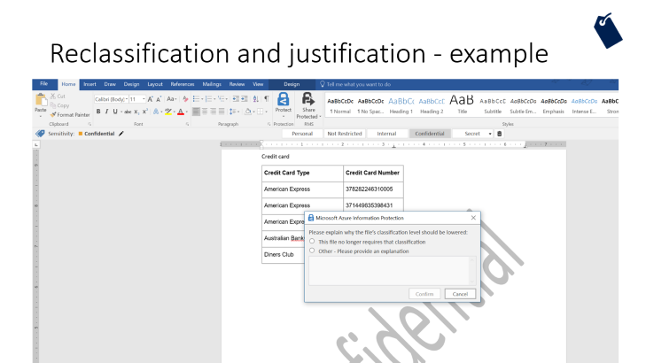
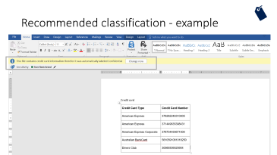

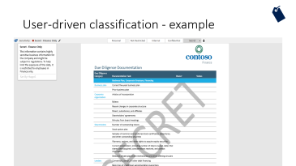


Azure Information Protection Experience
Notes:
Key Takeaway: This is what the integrate user experience for classification looks like

Slide 20

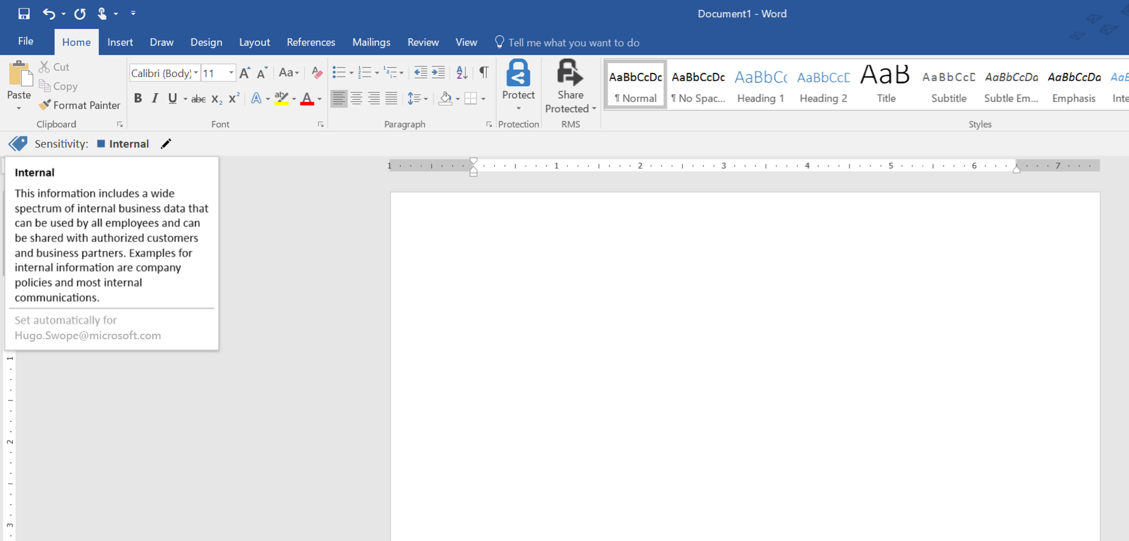
Automatic classification - example
Notes:
Key Takeaway: Automatic classification notifies you of the classification level and that it was automatically applied

Slide 21
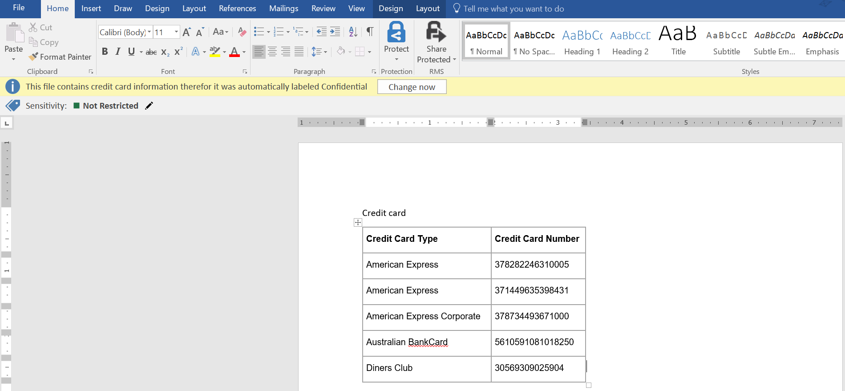
Recommended classification - example
Notes:
Key Takeaway: Recommended classification notifies you of the recommended classification level

Slide 22
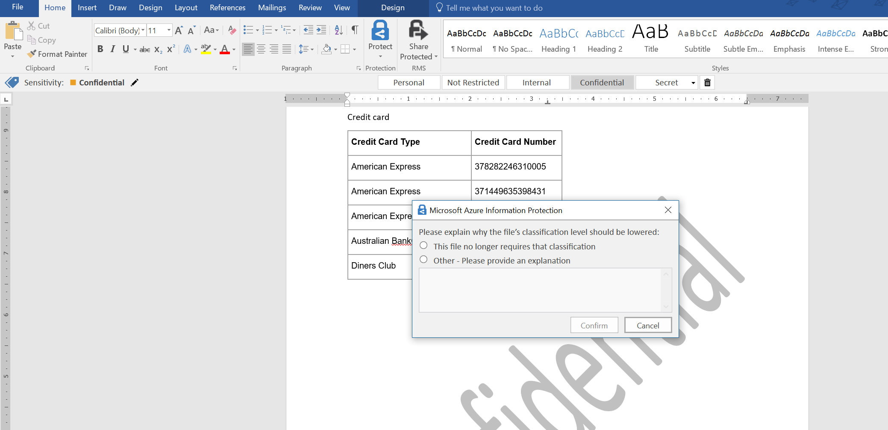
Reclassification and justification - example
Notes:
Key Takeaway: Reclassification can be configured to require users to explain why the classification level is being changed

Slide 23
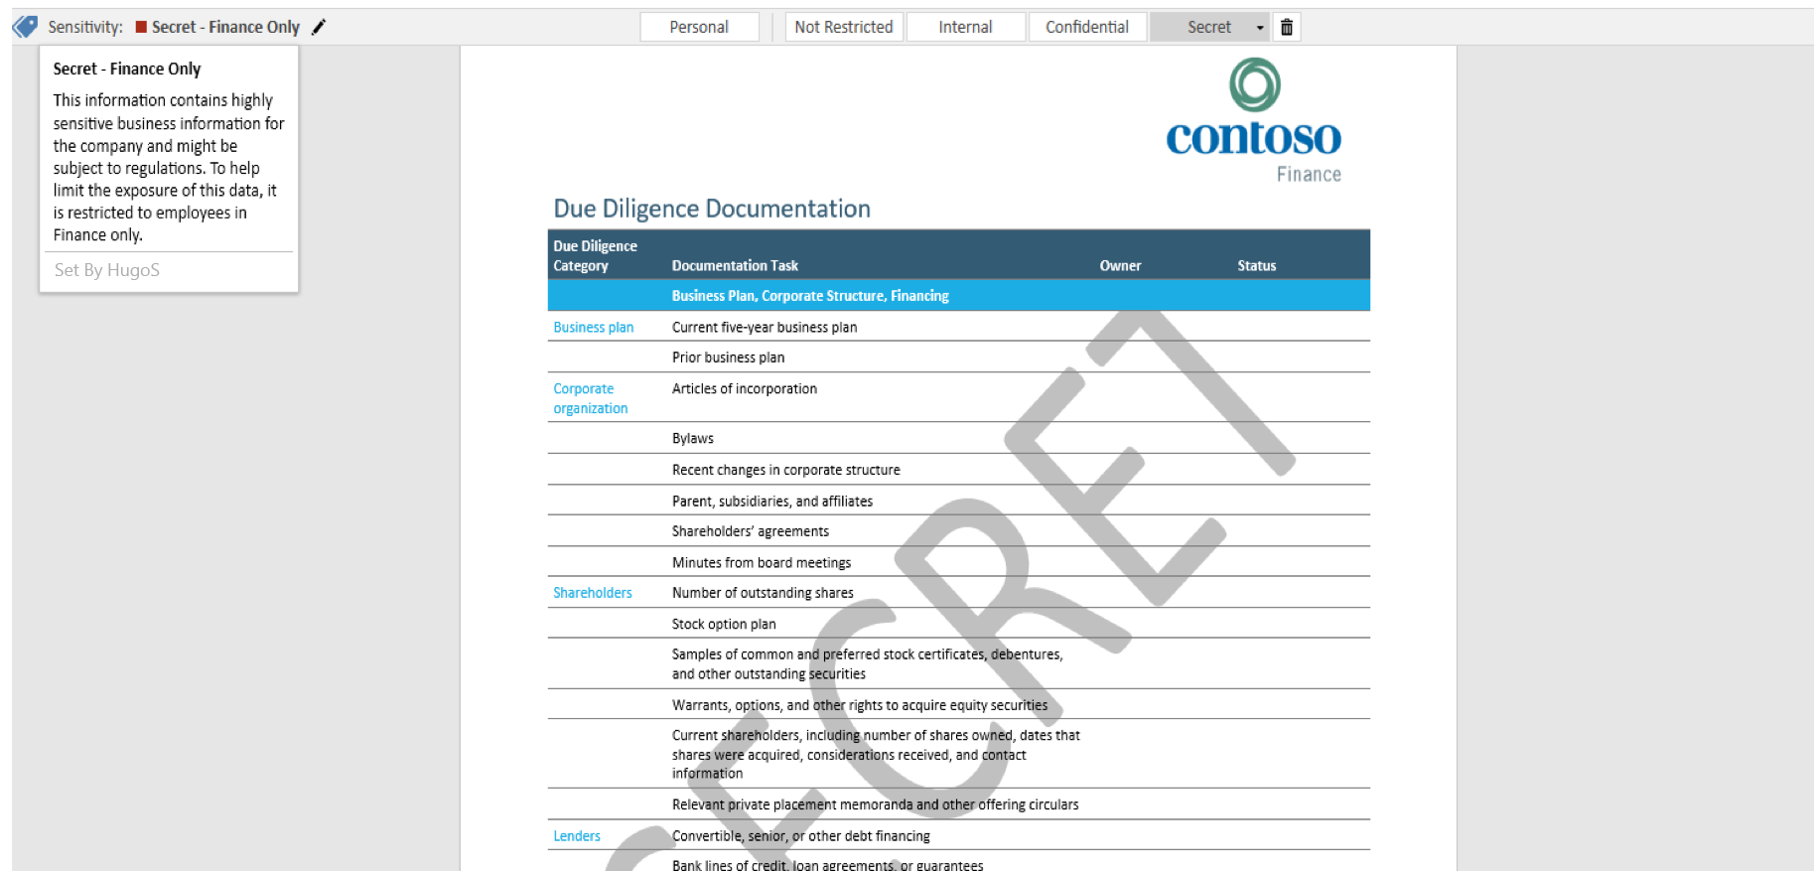
User-driven classification - example
Notes:
Key Takeaway: Manual classification process includes customizable guidance to help users identify the right classification label

Slide 24

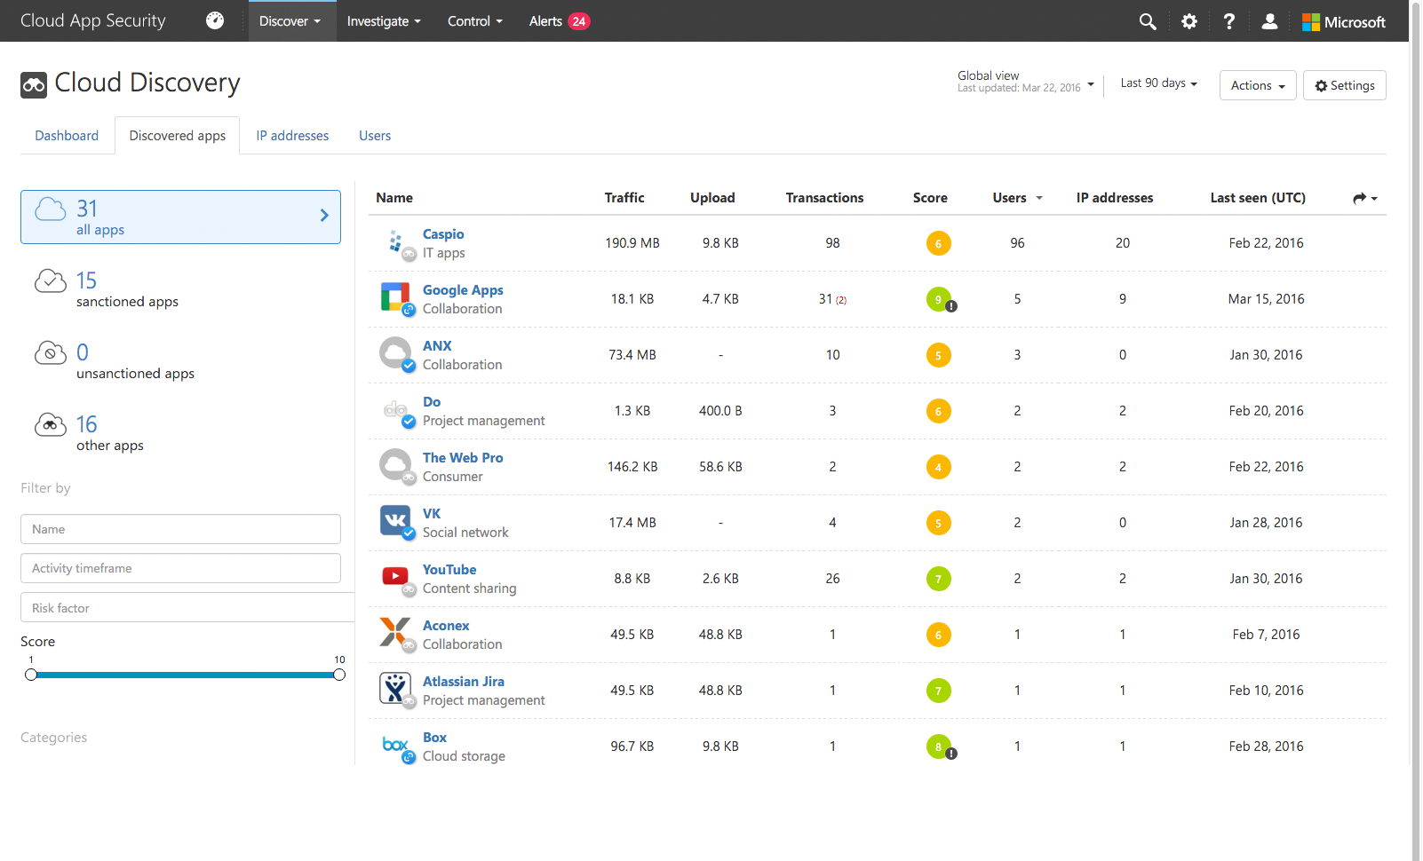
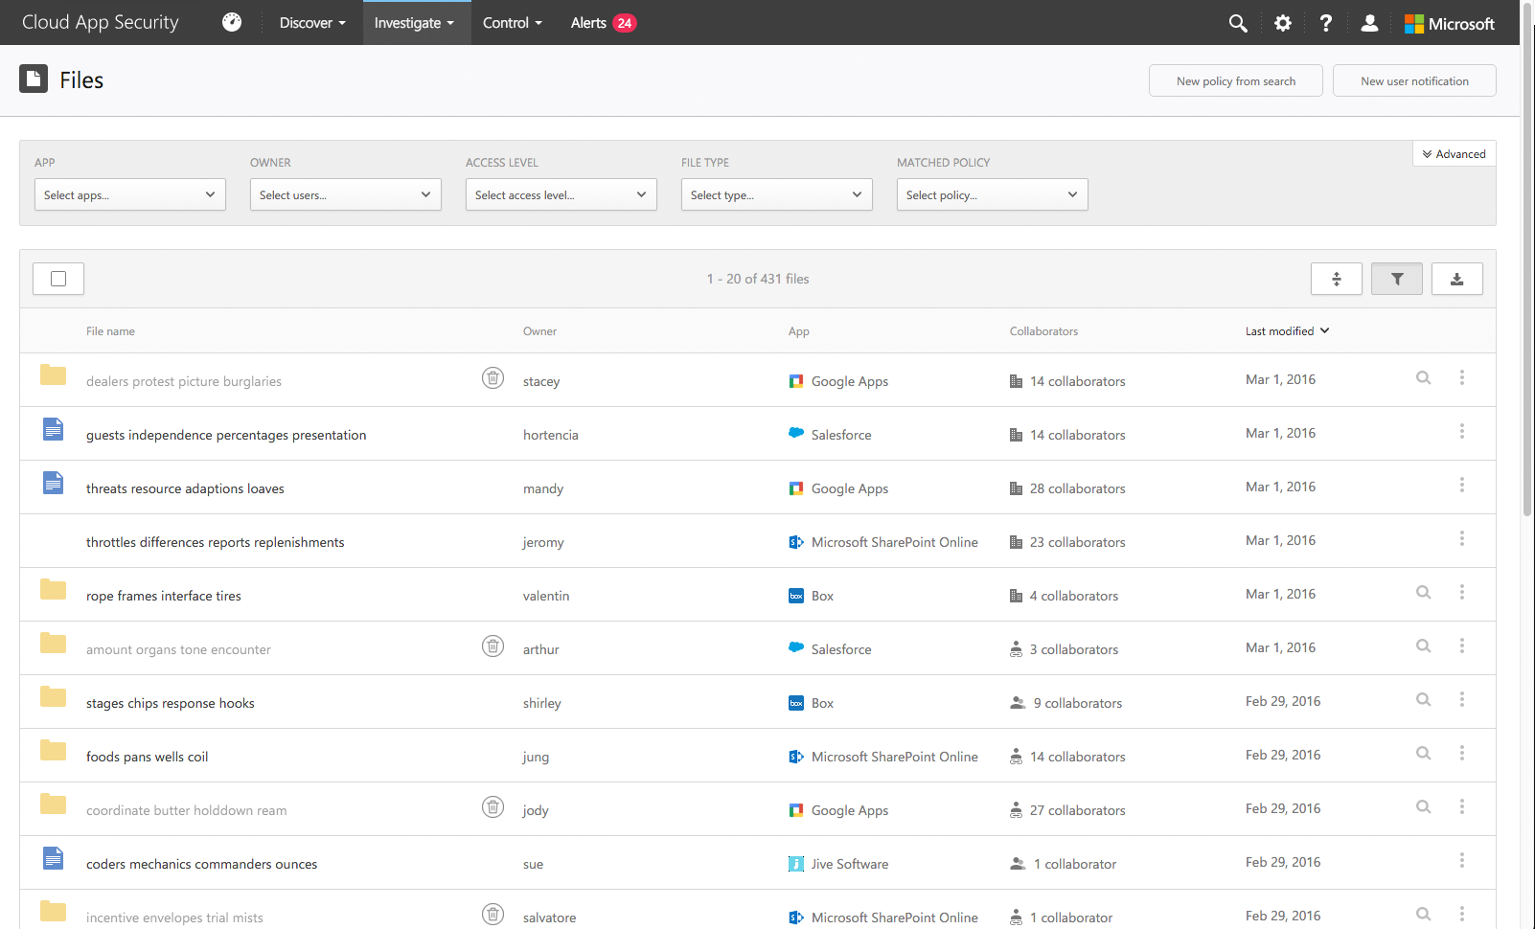
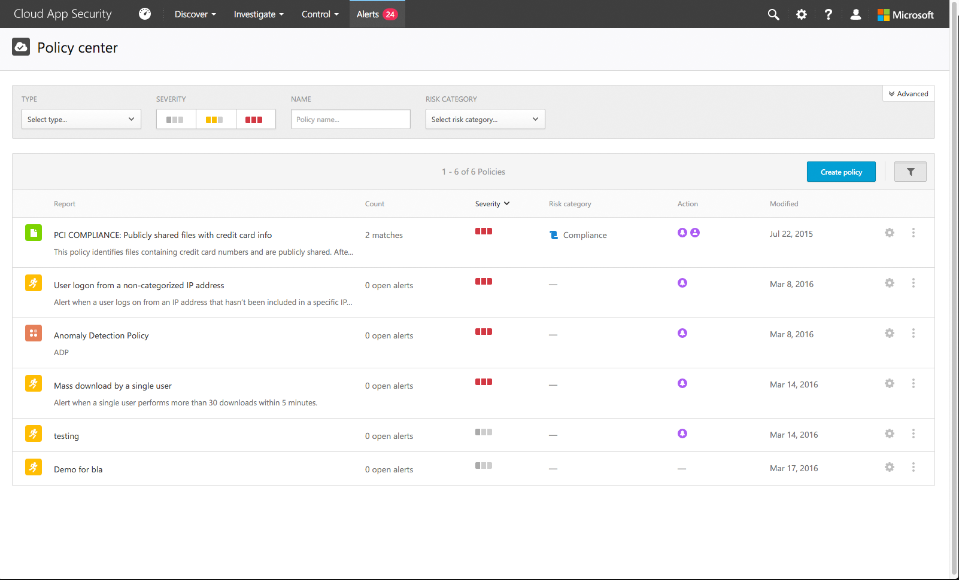



Finding and protecting data on SaaS
Discover
Discover
Discover
Investigate
Investigate
Investigate
Control
Control
Control
Alerts
Alerts
Alerts
Notes:
Key Takeaway: A Cloud Access Security Broker (CASB) like Microsoft Cloud App Security helps you reduce risk by find and managing “Shadow IT” Software as a Service (SaaS) applications in active use
For a prescriptive roadmap with more details, see Module 4a.
Whether or not you’ve approved use of cloud application, your employees are probably using them.
80% of employees recognize they use unsanctioned SaaS apps in their everyday job
(source: http://www.computing.co.uk/ctg/news/2321750/more-than-80-per-cent-of-employees-use-non-approved-saas-apps-report)
Discovery - The first step is to discover what applications the users are currently using. Cloud App Security identifies cloud applications (out of a library of 14,000+ known applications) in your network—from any device. No agents are required as the information is collected from your firewalls and proxies to give you complete visibility and context for cloud usage and shadow IT.
CLICK 1
Investigate – The next step is to evaluate the applications in use. Cloud App Security provides risk scoring (based on 60 parameters) to help you decide whether to sanction and managed the discovered applications or work with the users to migrate data onto approved applications.
CLICK 2
Control – Once you have identified which applications to approve, you can then start managing these sanctioned applications to get deeper visibility into their use and set granular controls and policies for data sharing and data loss prevention (DLP).
Additional Information
Cloud App Security also allows you to configure alerts and automatic actions (such as quarantining sensitive data that is shared openly on the internet)
Cloud App Security - https://www.microsoft.com/en-us/cloud-platform/cloud-app-security

Slide 25

Scenario: oversharing from sanctioned SaaS
1
IT department sanctions SaaS application and provisions user access
2
User uploads sensitive file to SaaS and shares openly with everyone
Unknown parties find and access the document, creating business risk
3a
Cloud app security detects oversharing of sensitive document, quarantines it, and issues alert
3
Notes:
Key Takeaway: Cloud App Security can help limit your risk for approved and managed SaaS applications
In this scenario the IT department has sanctioned one a Software as a Service (SaaS) application Office 365
CLICK 1
After users start using the service, one of them uploads a sensitive file to the service (such as a document that was automatically classified and labelled using azure information protection)
CLICK 2
Cloud App Security quickly detects this violation of your policy and automatically executes a response including
The file quarantine operation that you have configured
Emailing the user and their manager
Alerting the administrator
You have the control to configure other options for governance actions from a list that includes CAS alerts, email/text notification to user (or manager/admin/other), apply AIP protections to the file, change sharing permissions, quarantine file, quarantine user account, etc.
For the full list of governance actions, see https://docs.microsoft.com/en-us/cloud-app-security/governance-actions
Additional Information
Note that you can configure policies for many more risk situations, for more information see https://docs.microsoft.com/en-us/cloud-app-security/control-cloud-apps-with-policies
For more information on Cloud App Security and Azure Information Protection (AIP) integration, see https://docs.microsoft.com/en-us/cloud-app-security/azip-integration

Slide 26
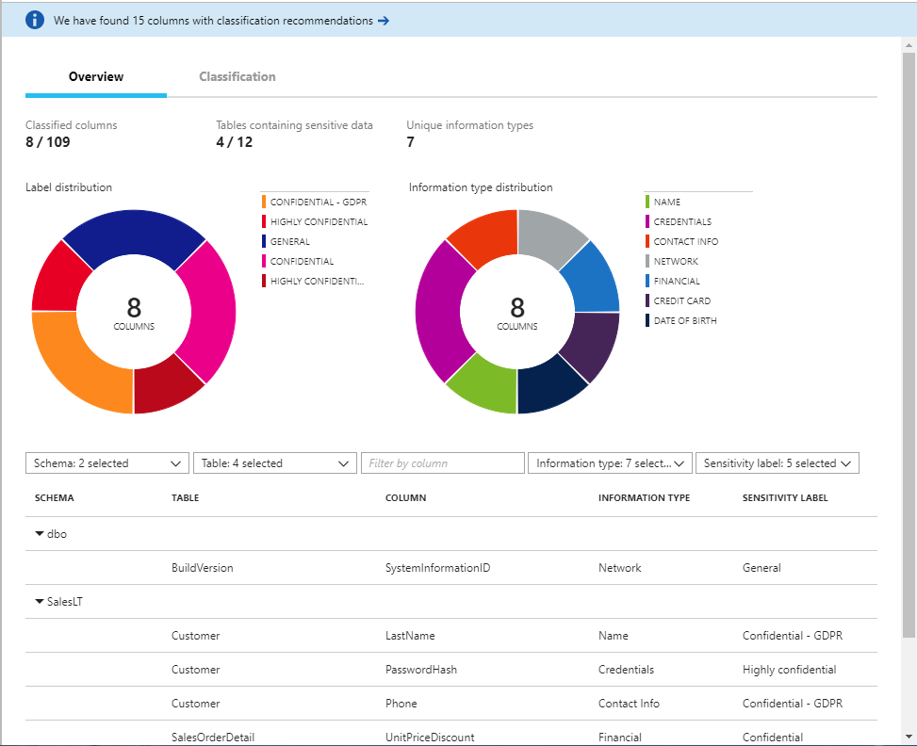
Secure the data, not just the SQL database
Creative Ask - basic cleanup
Automated discovery of sensitive data
Labeling (tagging) sensitive data on column level with persistency
Classification as infrastructure for protection & compliance
Audit access to sensitive data
Sensitivity metadata flows with data for protection outside database boundaries
Hybrid – cloud + on-premises
Centralized IP policy management
Notes:
Key Takeaway: This is a summary of challenges addressed by SQL Information Protection
For more information, see https://docs.microsoft.com/en-us/azure/security-center/security-center-info-protection-policy

Slide 27





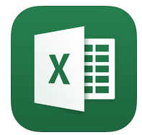












Mobile Application Management (MAM)
Managed apps
Managed apps
Multi-identity App
Corporate data
Works with or without MDM
Strong protections for corporate data
Restrict “Save as” and cut/copy/paste
Secure viewing of PDFs, images, videos
App encryption at rest
App access control – PIN or credentials
Managed web browsing
Support multi-identity applications
Selective wipe of corporate data without affecting personal data
Personal data
Restrict features, sharing and downloads
Personal apps
Personal apps
MDM – optional
(Intune or 3rd-party)
Notes:
Key Takeaway: Mobile Application Management allows you to provide security without compromising the first class mobile experience your users need to be productive
Mobile Application Management (MAM) works with or without the device being managed by a Mobile Device Management (MDM) solution like Intune or a 3rd party solution.
This enables you to use MAM whether you have existing MDM management of the device or an unmanaged personal device
The security assurances are stronger with a full MDM solution, but sometimes that isn’t feasible for all employees or partners (e.g. doctors that work for different hospital systems that all require security but device can only have one MDM)
CLICK 1
MAM allows you to provide strong protections for your corporate data by managing the security configurations of the mobile applications (to prevent save as, cut/copy/paste, PIN enforcement, and additional encryption and security features.
CLICK 2
The Intune MAM capability supports multi-identity usage of apps so you can have different levels of protections/restrictions for corporate data vs. personal data on the same application.
CLICK 3
Selective wipe allows you to remove your corporate data without impacting any of the users personal files or documents.

Slide 28
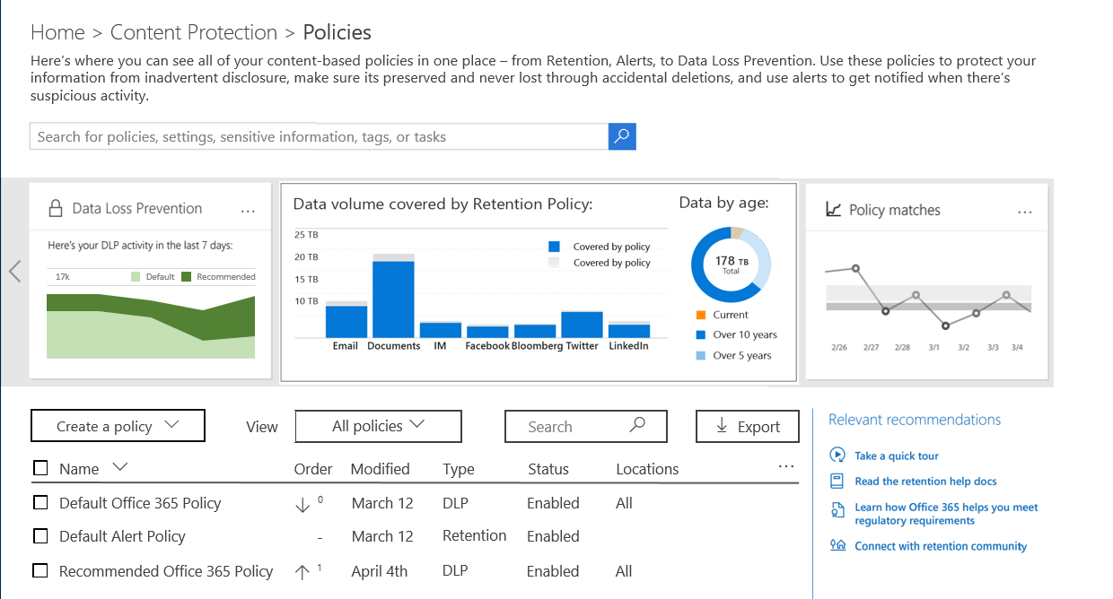
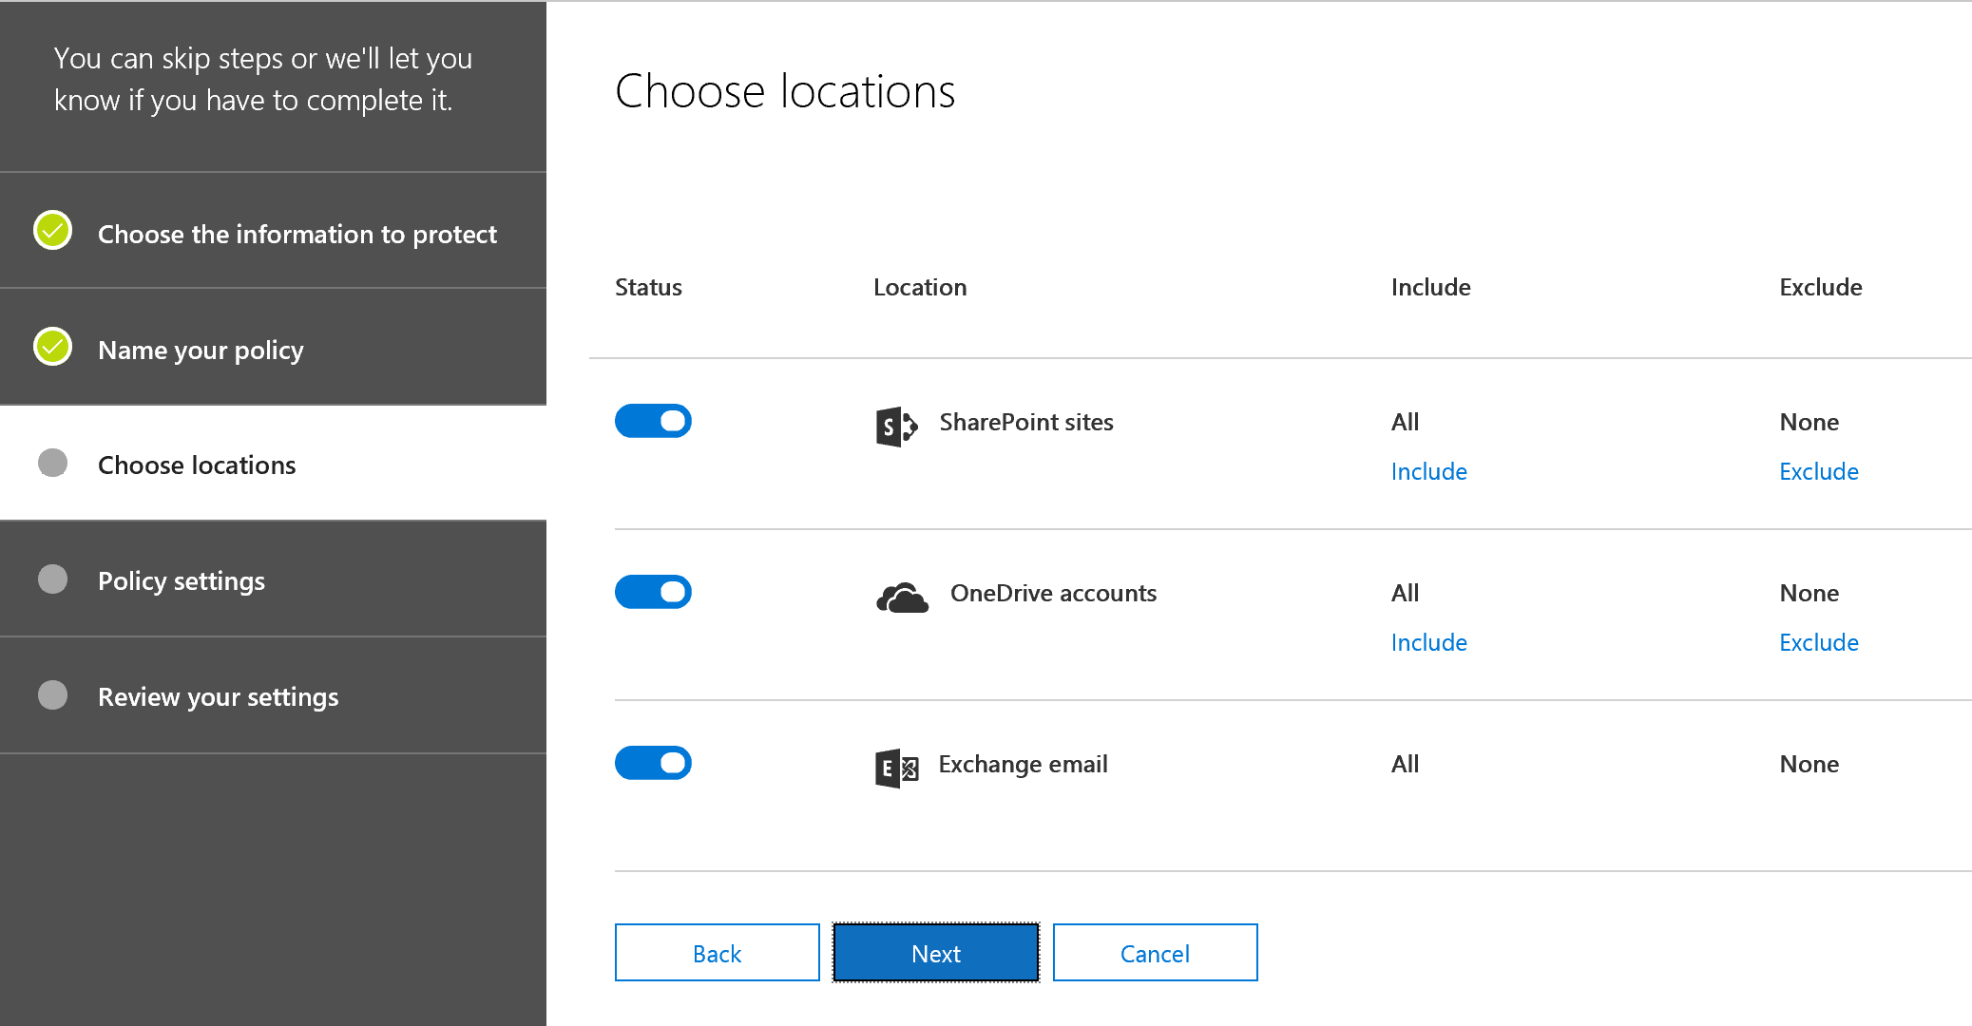
Sophisticated Built-in Protection Across Office 365
Centralized console - define policy once, apply across Office 365 services and client end-points
Built in to Exchange Online, SharePoint Online, and OneDrive for Business
Focused on secure productivity
Admins - Default policy for most common sensitive content (which can be customized)
Users - Policy Tips integrate security education into user workflow
Notes:
Key Takeaway: Microsoft has built in DLP protections to the Office 365 platform

Slide 29
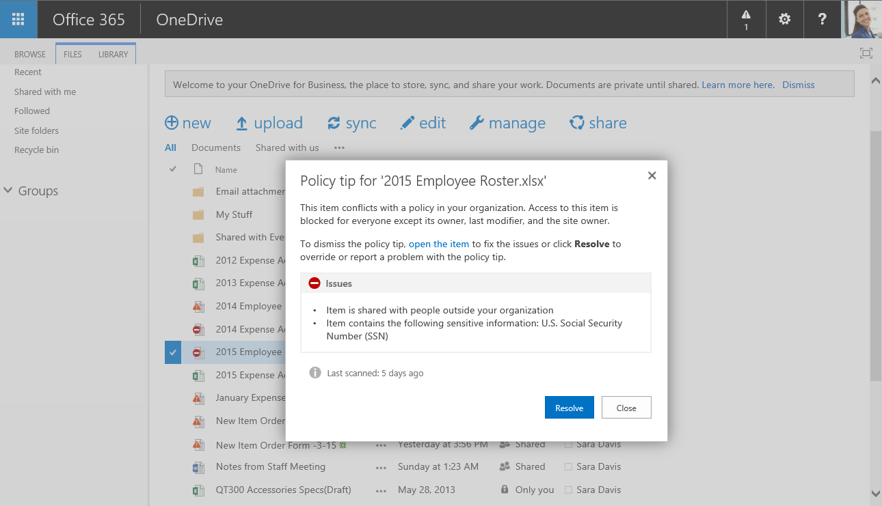
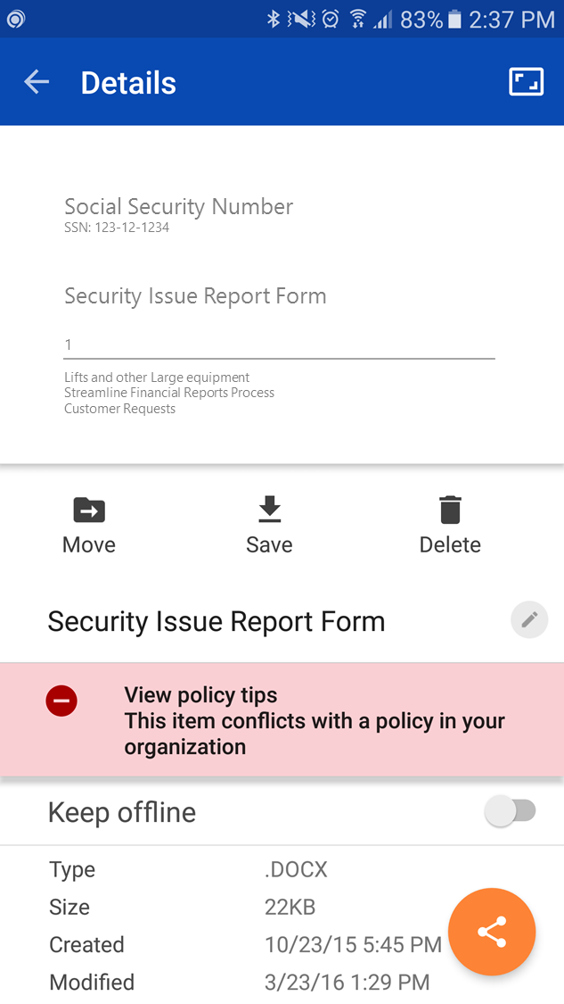
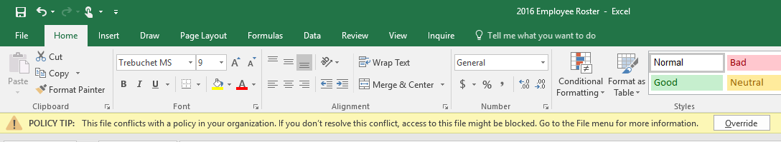
Balancing User Productivity and Risk
Policy Tips help educate users when they are about to violate a policy
Available in desktop, web, and mobile apps
Notes:
Key Takeaway: Microsoft has built in education (via Policy Tips) to help users make the right decision in the course of their workflow when they are thinking about the document.

Slide 30
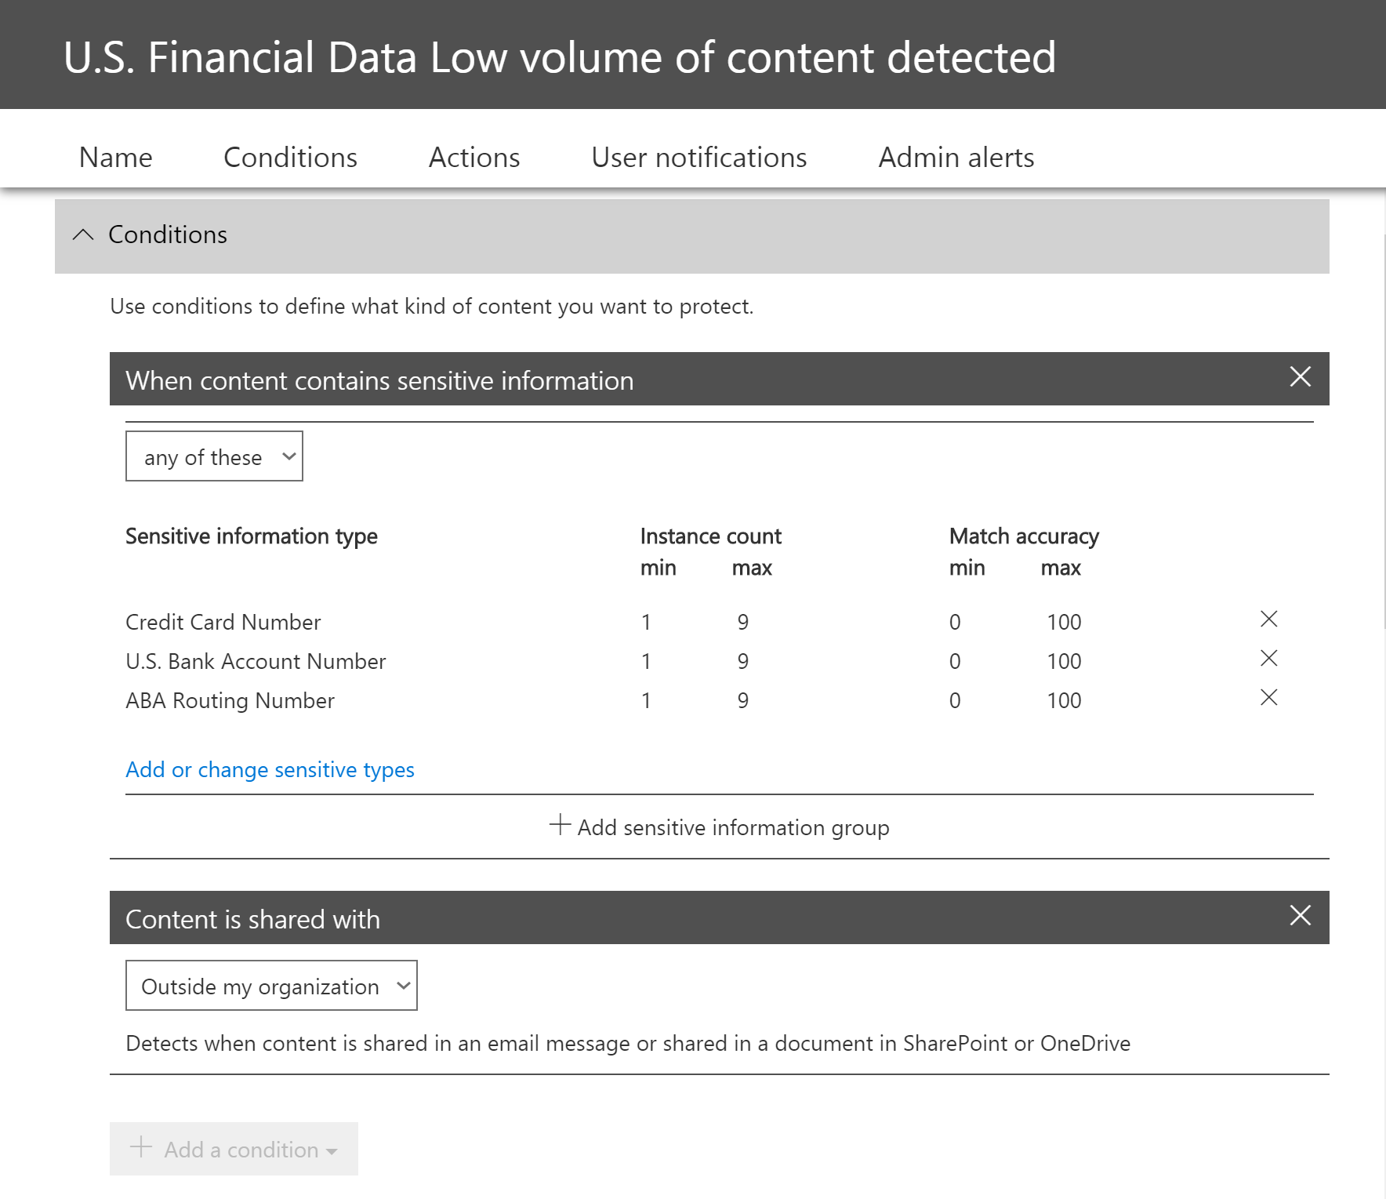
DLP Policy Rules - Conditions
Describe the policy objective – model business risk and mitigation actions
Set of conditions describing when rule applies
Set of actions applied when conditions match
Range of actions covering insights and automatic remediation
Generic action behavior integrated for natural experience across each workload
Notes:
This is an overview of the types of conditions you can set on Office 365 DLP policy rules

Slide 31
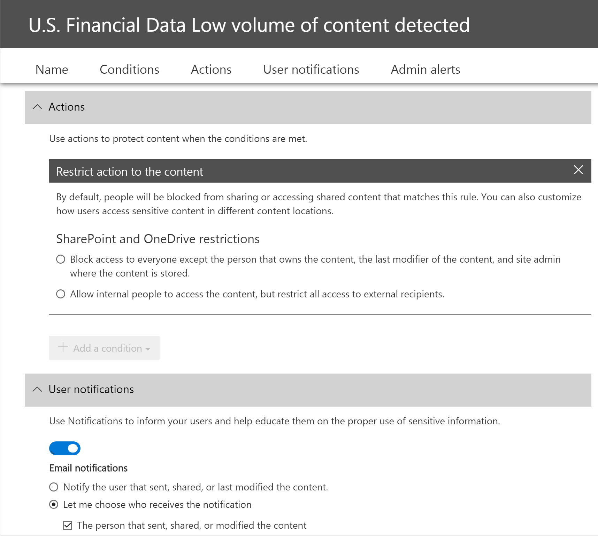
DLP Policy Rules - Actions
Describe the policy objective – model business risk and mitigation actions
Set of conditions describing when rule applies
Set of actions applied when conditions match
Range of actions covering insights and automatic remediation
Generic action behavior integrated for natural experience across each workload
Notes:
This is an overview of the types of actions you can take with Office 365 DLP policy rules

Slide 32
Securing Structured Data in Azure SQL
Activity Monitoring
Tracking activities : Auditing
Detecting threats : Advanced Threat Detection
Centralized dashboard : ASC Integration & OMS Integration
Access Control
Server access : SQL Firewall
Database access: : SQL and Active Directory Authentication
Application access : Row-Level Security and Dynamic Data Masking
Data Protection
Encryption in transit : Transport Layer Security
Encryption at rest : Transparent Data Encryption
Encryption in use : Always Encrypted
Compliance: FedRAMP, HIPAA, PCI, EU Model Clauses , UK G-Cloud, ISO,
(government), (medical), (payment), (personal), (public sector)
Notes:
Key Takeaway: Azure SQL offers several types of protection; Activity Monitoring, Access Control, Data Protection
Data Protection – Data encryption in use, over the network, and at rest in the database
https://docs.microsoft.com/en-us/sql/relational-databases/security/encryption/transparent-data-encryption-with-azure-sql-database
CLICK 1
Access Control – You can configure Azure SQL Firewall, configure SQL or Active Directory for authentication, and apply row level security and dynamic data masking
SQL Firewall - https://docs.microsoft.com/en-us/azure/sql-database/sql-database-firewall-configure
Row Level Security - https://docs.microsoft.com/en-us/sql/relational-databases/security/row-level-security
Dynamic Data Masking - https://docs.microsoft.com/en-us/sql/relational-databases/security/dynamic-data-masking
CLICK 2
Azure SQL also detailed auditing as well as advanced threat detection analytics that provide insights into the audit logs. Threat detection continues to evolve and currently includes
SQL injection attacks (attempts and successful exploitation),
Anomalous database access patterns (unusual location, unfamiliar principal, brute force)
Auditing - https://docs.microsoft.com/en-us/azure/sql-database/sql-database-auditing
Threat Detection - https://docs.microsoft.com/en-us/azure/sql-database/sql-database-threat-detection

Slide 33

Recommended Topology Azure Information Protection
optional
Azure AD
Azure Rights Management
Azure Key Management
Data protection for organizations at different stages of cloud adoption
Ensures security because sensitive data is not sent to the RMS server
Integration with on-premises assets with minimal effort
Authentication & collaboration
BYO Key
Authorization requests go to a federation service
RMS connector
AAD Connect
ADFS
Notes:
Key Takeaway: The recommended topology for Azure Information Protection is to leverage the Azure Rights Management capability that enables documents to be access and protected when they have access to the internet

Slide 34
Regulated Topology Azure Information Protection
optional
Azure AD
Azure Rights Management
Azure Key Management
Data protection for organizations at different stages of cloud adoption
Ensures security because sensitive data is not sent to the RMS server
Integration with on-premises assets with minimal effort
Hold Your Own Key with on-premises key retention
Authentication & collaboration
BYO Key
Authorization requests go to a federation service
RMS connector
AAD Connect
ADFS
Rights Management
Key Management
No DMZ Exposure
Notes:
Key Takeaway: Some organizations have requirements to retain master key control on-premises for certain classifications of data and we provide support for this topology.
Depending on the policy configuration, this can limit the ability to access documents to only on-premises connected hosts.

